Slide 2
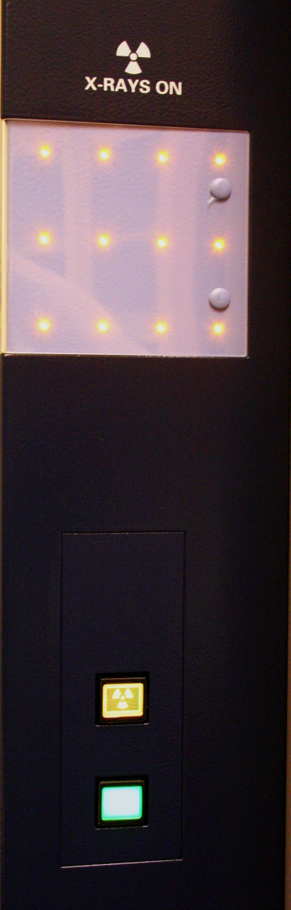
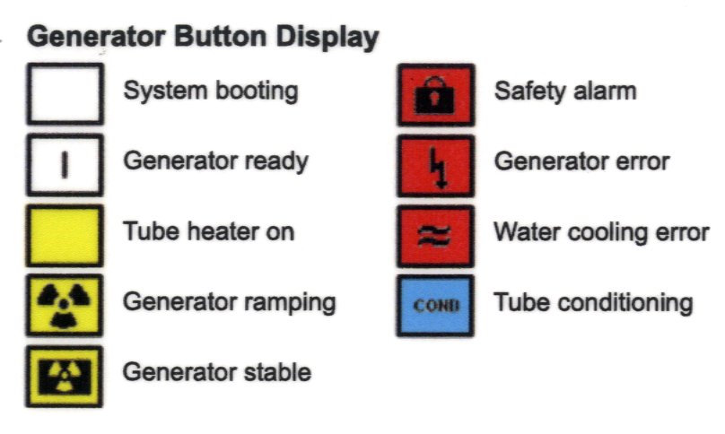
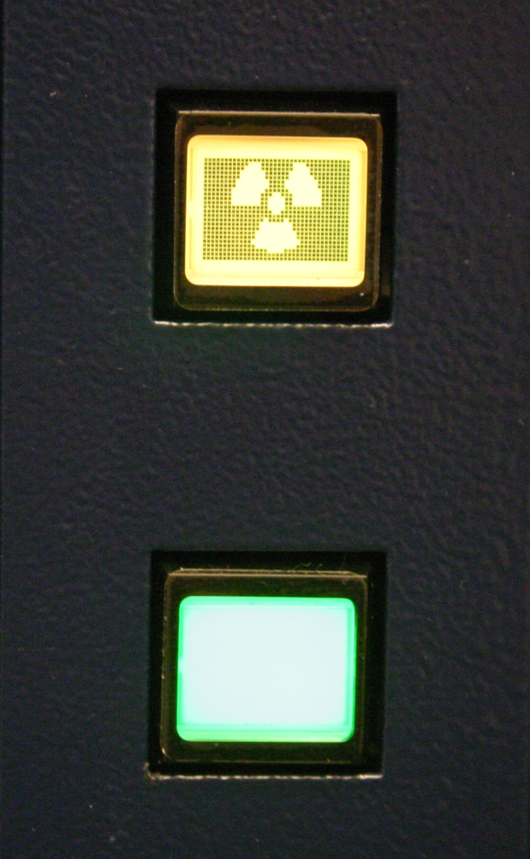
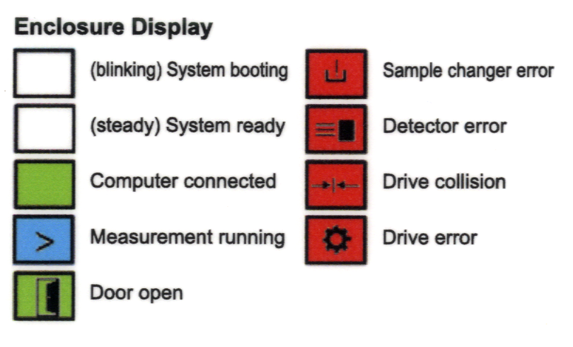
Bruker d8 Generator and Enclosure Display Settings (left side front of d8)
Yellow LED array here
and on tube assy.
means X-rays are on
Generator Button Display
Generator ready
Enclosure Display
Green : Measurement server connected
Blue > : Scan in progress
White : Measurement server not connected

Slide 3
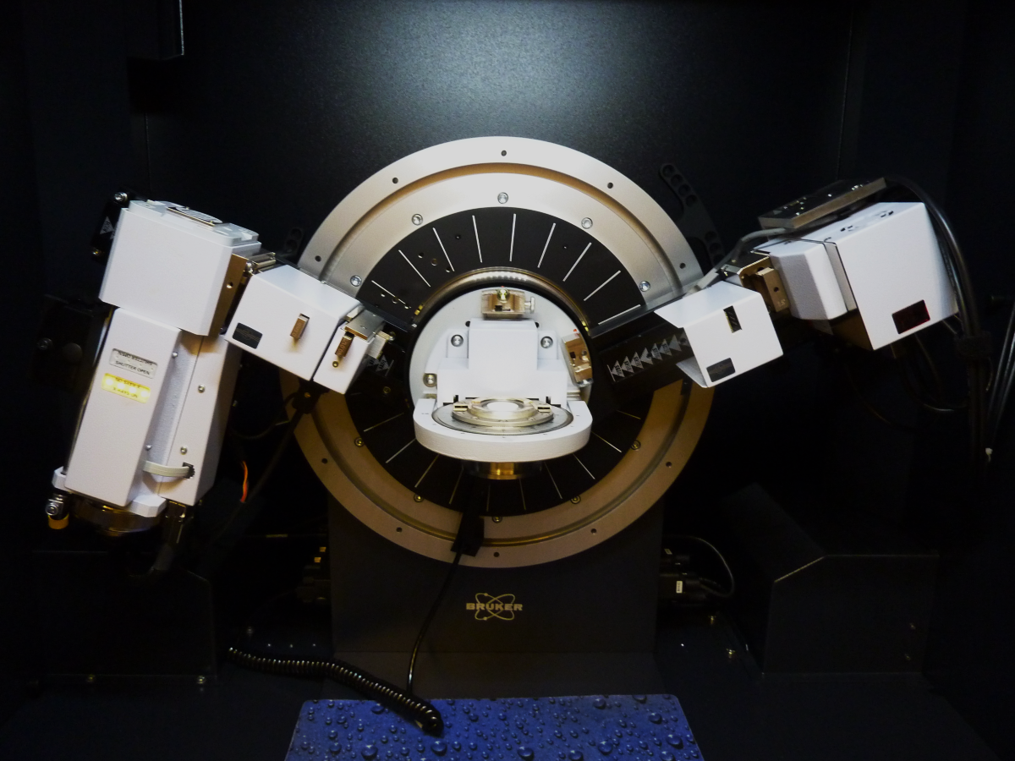
Bruker d8 Goniometer Configuration
X-ray tube
Cu source
Lynxeye XE detector
Anti-scatter fin
Here empty
LED indicators
Upper red when shutter open
Lower yellow when tube on
Module D
Lynxeye Left and Right
Left: filter typically empty
Right: Soller 2.5 degree slit
Sample holder
Module A
Default: 0.6 mm anti-scatter slit
Always use
Module B (left)
Default: Ni filter 0.0125 mm
Ni filter Cu Kβ removal
Here empty
Module B (right)
Soller slit 2.5 degrees
Always use
Module C
Receiving slit / Ni filter
No slits are used with Lynxeye

Slide 4
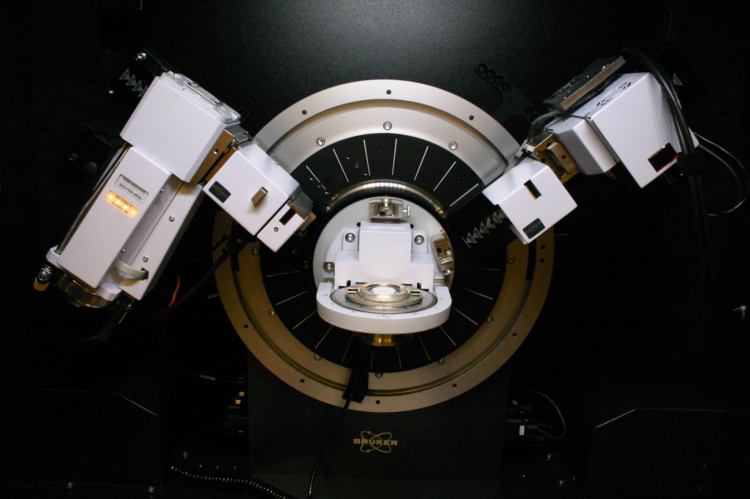
Bruker d8 Goniometer Configuration
X-ray tube
Cu source
Lynxeye XE detector
Anti-scatter fin
Here empty
LED indicators
Upper red when shutter open
Lower yellow when tube on
Module D
Lynxeye Left and Right
Left: filter typically empty
Right: Soller 2.5 degree slit
Module A
Default: 0.6 mm anti-scatter slit
Always use
Sample holder
Module C
Receiving slit / Ni filter
No slits are used with Lynxeye
Module B (left)
Default: Ni filter 0.0125 mm
Ni filter Cu Kβ removal
Here empty
Module B (right)
Soller slit 2.5 degrees
Always use

